Slide 1
THE PRINCIPLE OF SUSTAINABILITY

Slide 2
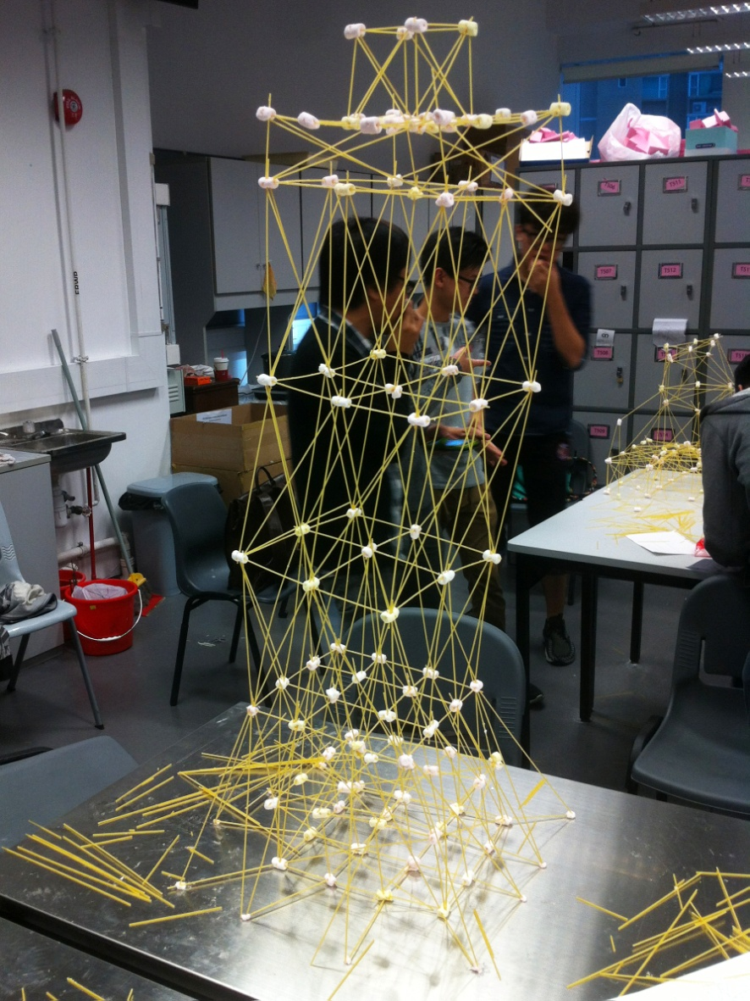
EXPERIMENT
What type of tower construction prove the best? Why?
What, on the other hand, did not work well?
Notes:
https://fayefan324.wordpress.com/category/spaghetti-tower/

Slide 3
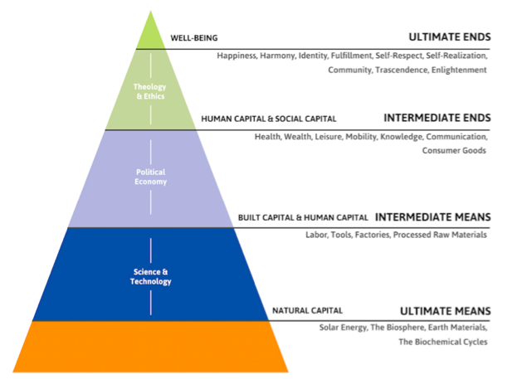
SUSTAINABILITY
Society is built up on natural resources – the broadest, lowermost part of pyramid
Rich natural resources represent stability and prosperity of human society
Human society can not flourish without care for nature - the base of pyramid - on the first place

Slide 4
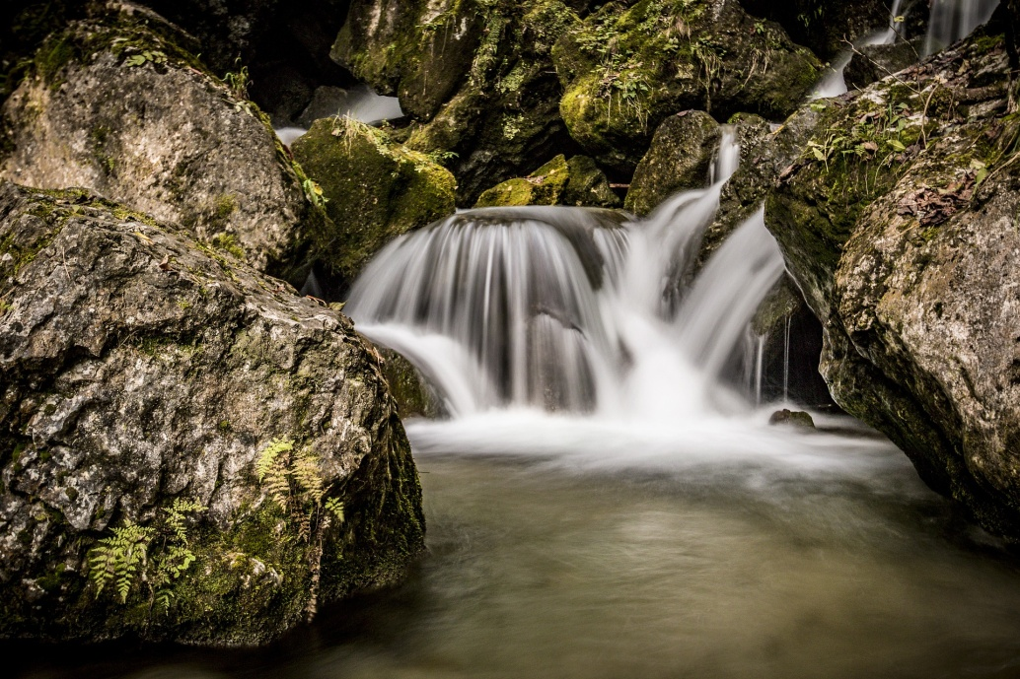
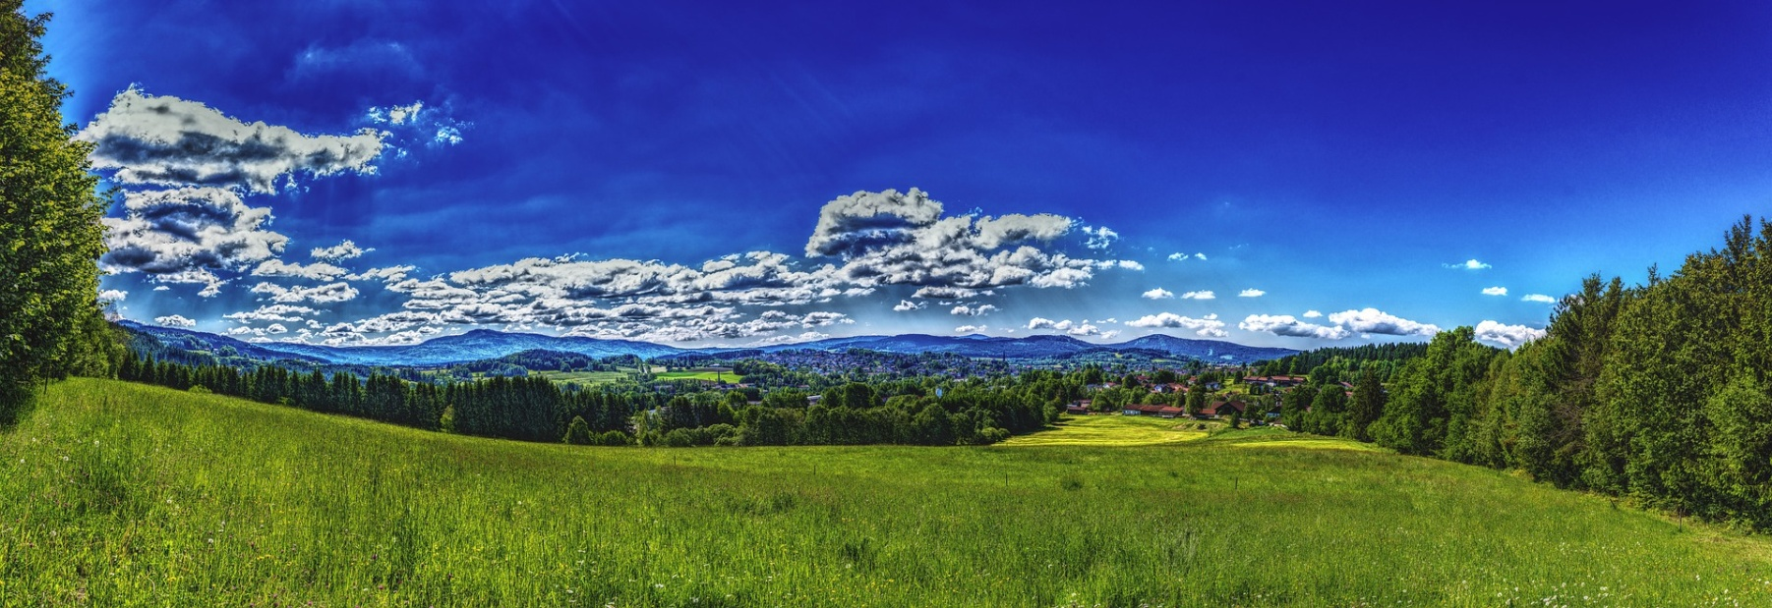
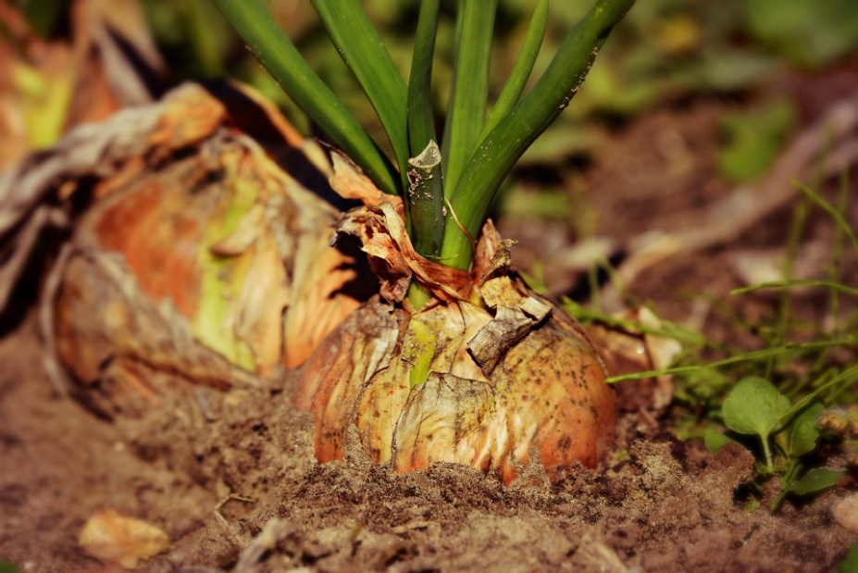
SUSTAINABILITY
Without healthy nature - clean air and water, fertile soil that retains water, species richness of plants and animals - people cannot live a happy life
Care for nature and the environment must come first for a healthy society
Notes:
https://pixabay.com/photos/onion-vegetable-plant-food-3706937/
https://pixabay.com/photos/water-bach-river-waterfall-nature-1563220/
https://pixabay.com/photos/panorama-bavarian-forest-forest-2354183/

Slide 5
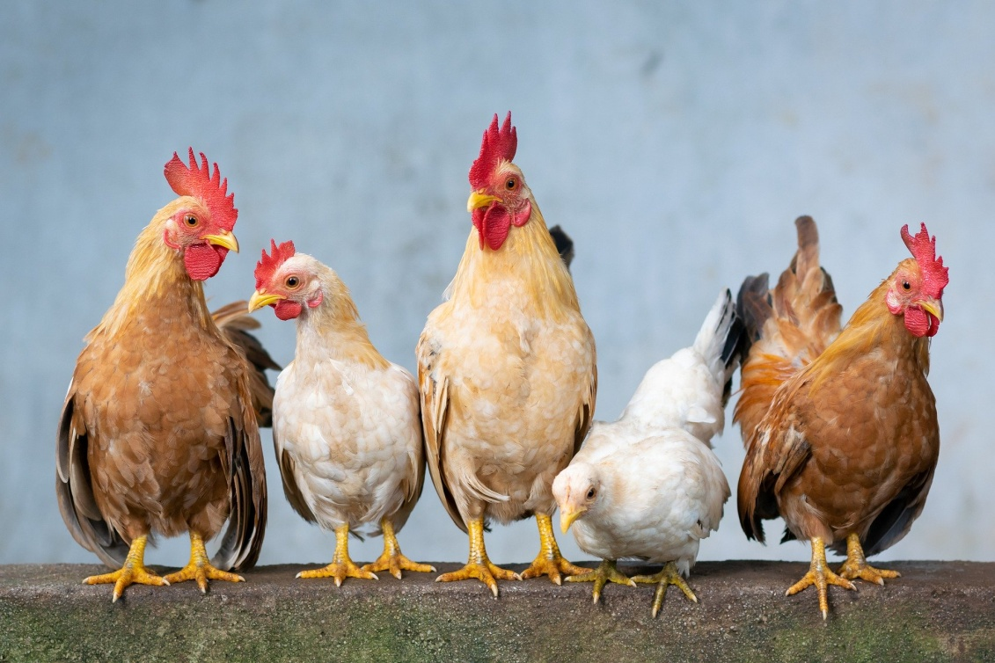
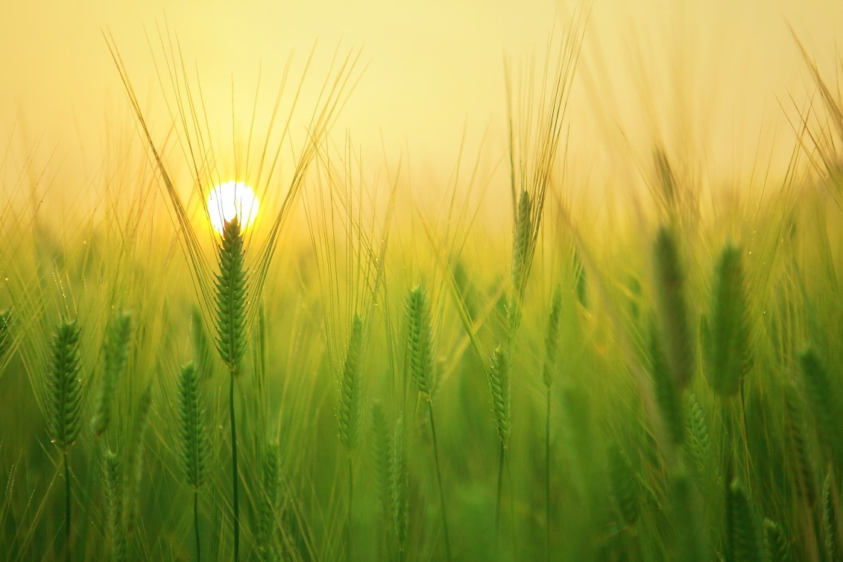
DISCUSSION
12 -13 years
Is nature important for people and why?
Could we live without it (animals, plants...) and what would be different if they disappeared?
Where do you think our food comes from and what roles do the organisms and plants play?
Notes:
https://pixabay.com/photos/chicken-hen-egg-rooster-chicks-4849979/
https://pixabay.com/photos/barley-field-wheat-harvest-sunrise-1684052/

Slide 6
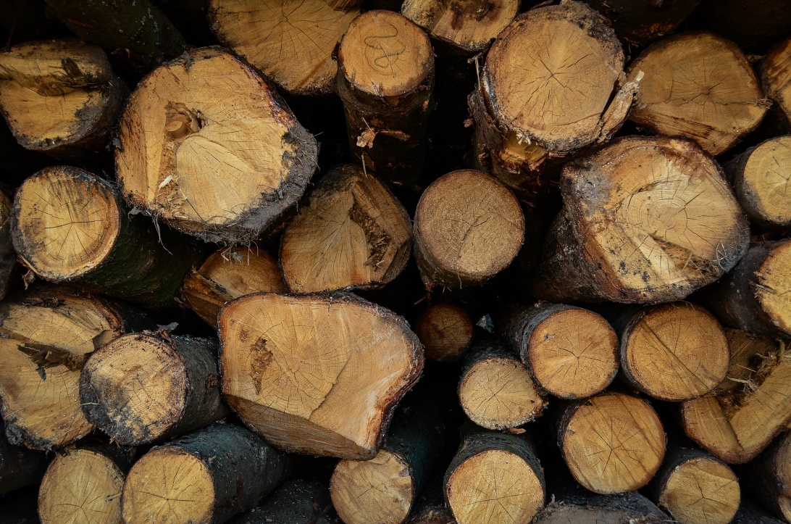
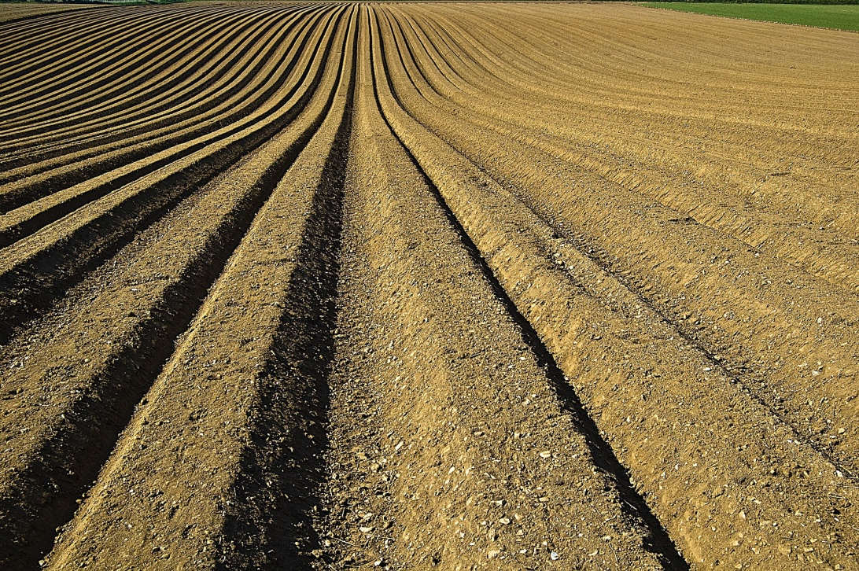
DISCUSSION
14 – 15 years
Does ‘wealth’ mean a lot of money, friends or food? How are these related?
Will I think of having friends if I am hungry?
Will money have value if there is no food to be bought in the first place?
What are the basics of human well-being?
What role does nature play in all this, are the animals part of wealth production and how?
Is it a good idea to exploit nature – to harvest all the wood and all the fields and turn it into money?
What should be protected and how much of it?
Are there ways to avoid the conflict between people, the economy, and loss of nature?
Notes:
https://pixabay.com/photos/forest-saw-harvesting-trees-block-761781/
https://pixabay.com/photos/crop-furrows-soil-seeds-1149914/

Slide 7
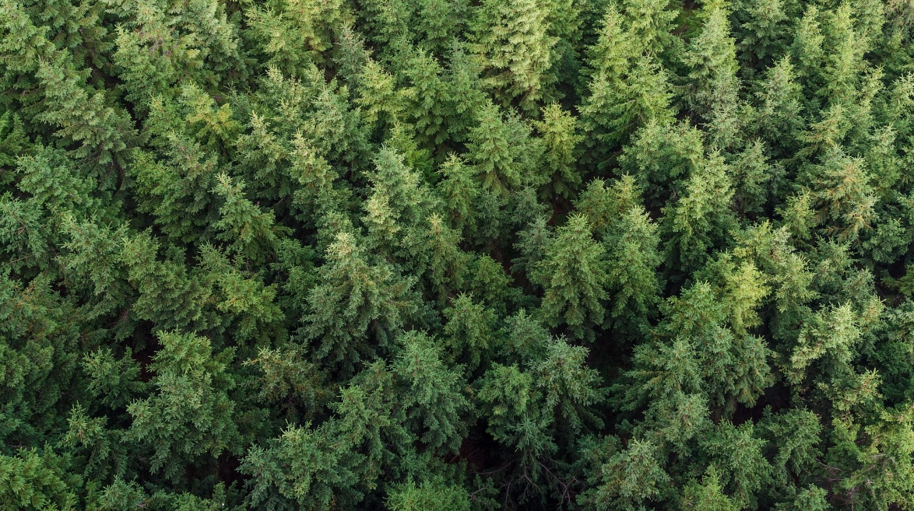
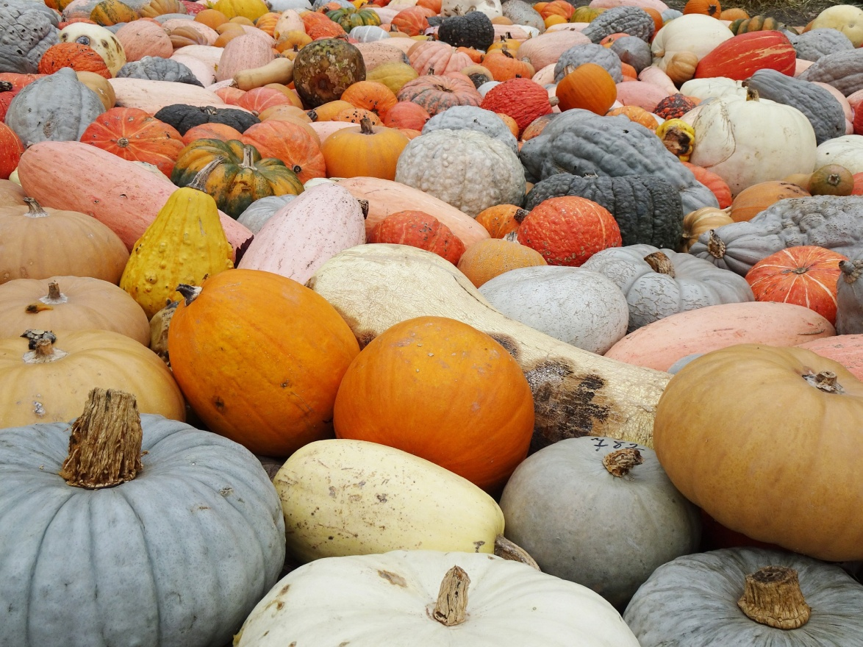
DISCUSSION
15 - 16 years
Is it better to specialize in one profession or learn more skills?
Is it better to grow one type of crops or several? What happens if there is a drought event or a pest which eats specific fruit or crop ?
Is it better to have just one species of tree in a forest or several? Why? What could go wrong if I grow just one?
Think about the role of diversity in nature and compare it to examples of diversity in society (e.g. cultural, genetic, skills and talents)?
Can we also find diversity related mechanisms which ensure resistance to changes?
Can too much diversity be harmful?
Notes:
https://pixabay.com/photos/plant-texture-nature-conifer-green-2717148/
https://pixabay.com/photos/pumpkins-hidden-object-diversity-4600419/

