Slide 1
ADVANTAGE OF SYMBIOSIS

Slide 2
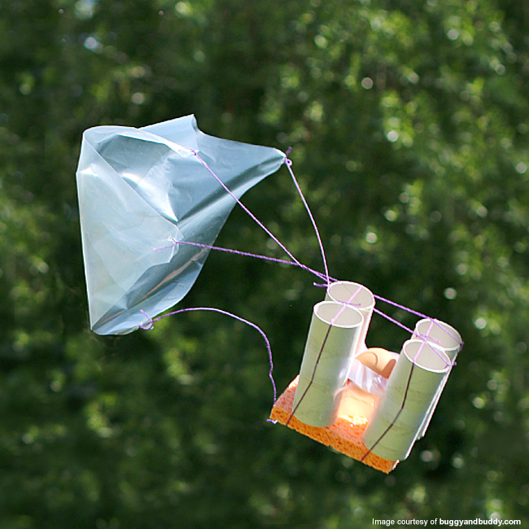
EXPERIMENT
What was the biggest problem and what helped to sort it out?
How did individual members do and what roles did you have?
What would you do differently?
What did you learn?
Notes:
http://blog.educationalinsights.com/crack-the-norm-six-egg-citing-egg-drop-experiment-ideas/

Slide 3
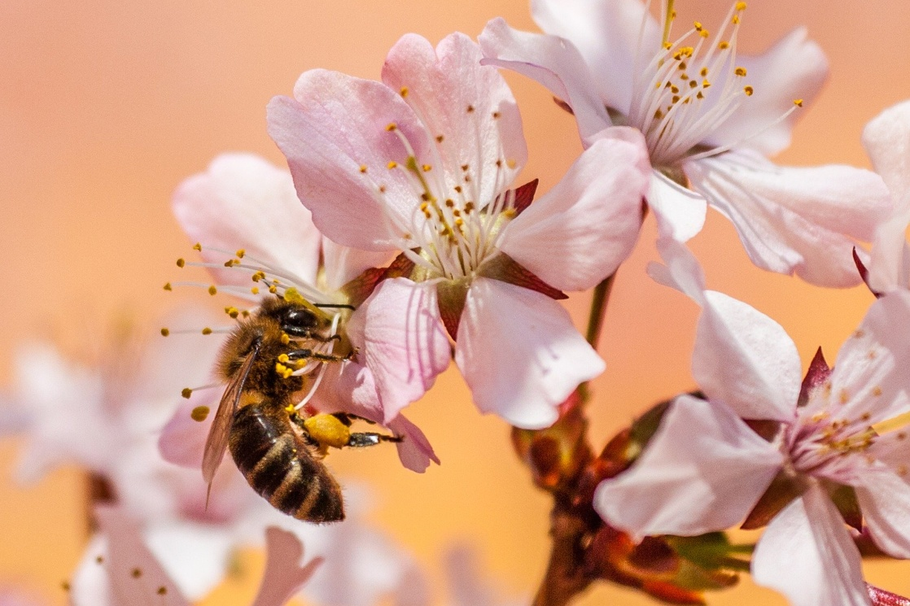
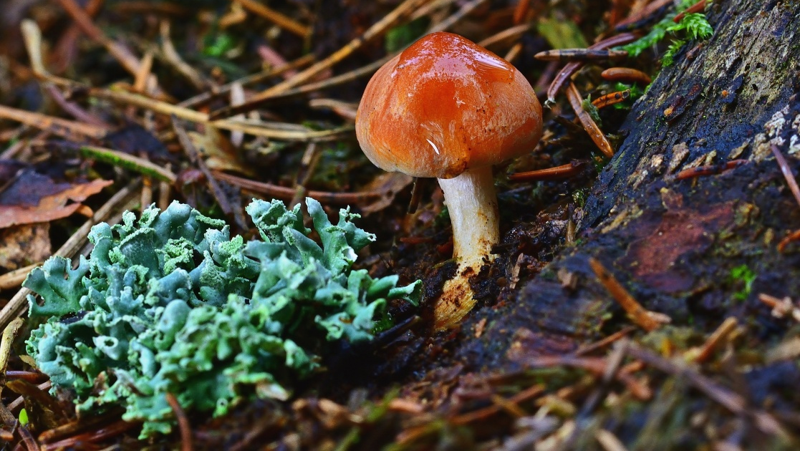
COOPERATION IN NATURE
Common between unrelated organisms - symbiosis
Advantageous for all individuals involved
For example the relation plant – pollinator is also vital for people; thanks to this relation we have fruits and vegetables
Relation between fungus and plant is called mycorrhizae – probably every plant has its own fungus; thanks to it they can receive more water and nutrients from soil, fungus receives in return organic compounds (sugars)
Notes:
https://pixabay.com/photos/bee-insect-honey-bee-pollen-garden-5219887/
https://pixabay.com/photos/forest-mushroom-lichen-4935630/

Slide 4
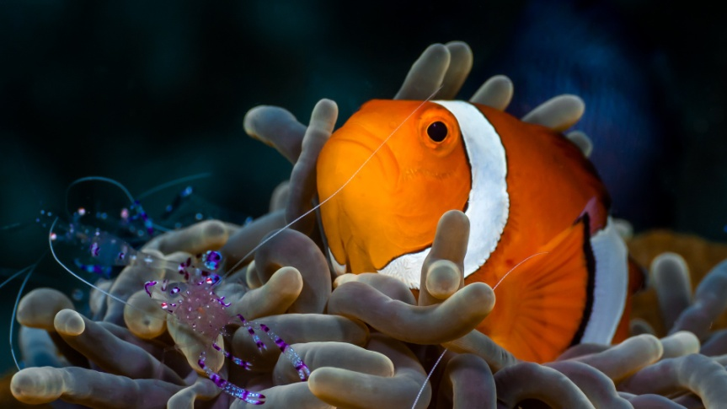
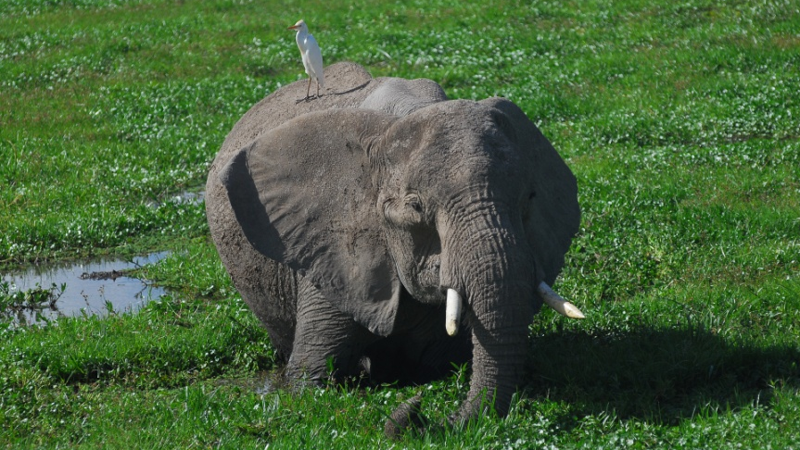
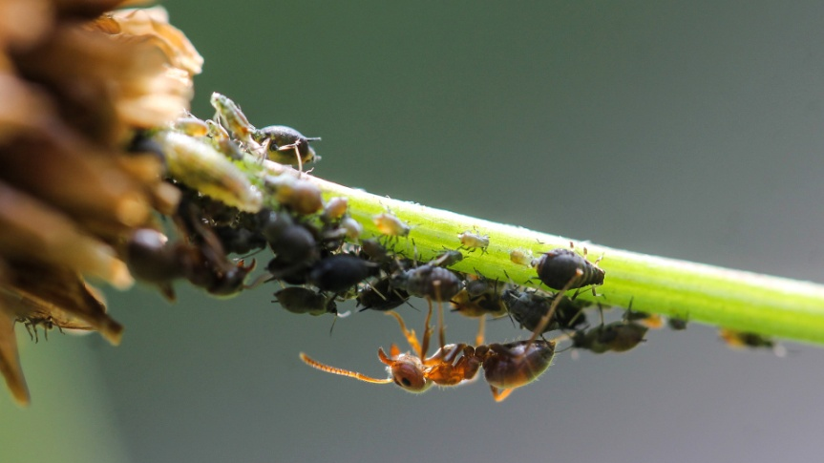
DISCUSSION
Why is it better to do things together than doing them alone?
Imagine your situation in a school
Should everyone be taught the same topics at the same time, or should individual talents be expressed instead?
How should we think of efficient teams?
Which members and talents should be included?
Can you think of some examples of teams in nature?
How about a troop of monkeys, antelopes, elephants, ant mounds, etc.?
Why do some animals have certain roles – does it have any relation to their predispositions?
Notes:
https://pixabay.com/photos/nemo-anemone-fish-underwater-sea-5029677/
https://pixabay.com/photos/earth-hour-fall-equinox-elephant-4504049/
https://pixabay.com/photos/ant-blackfly-lice-macro-insect-3986720/

