Slide 1
Ekonomika mycelia Cirkulární vs. lineární ekonomika

Slide 2
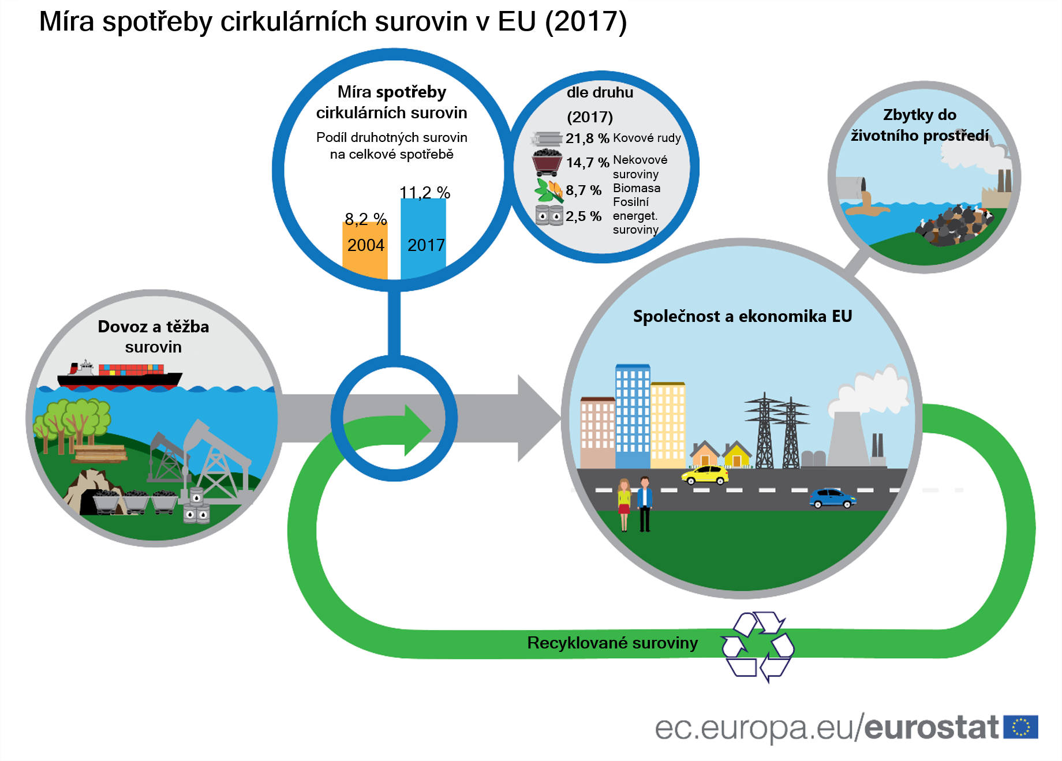
Spotřeba surovin v Evropě
Notes:
The diagram shows that although some materials are recovered in the economy, much of it…almost 90%...is ‘lost.’
https://ec.europa.eu/eurostat/web/products-eurostat-news/-/DDN-20200312-1

Slide 3
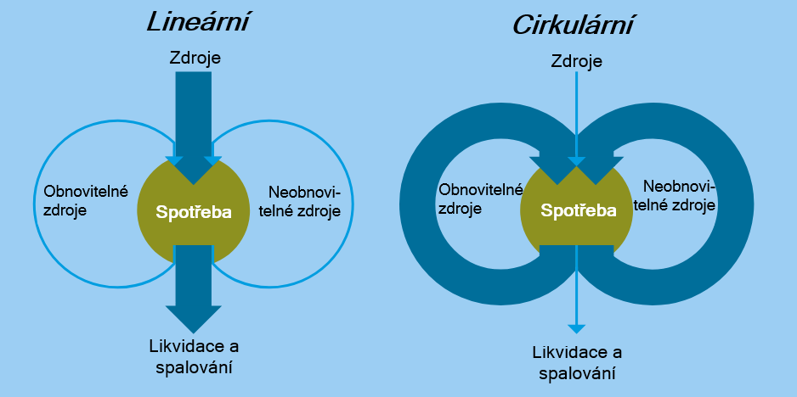
Od lineární k cirkulární ekonomice
Zdroj: Rood T a Hanemaaijer A, (2017). Opportunities for a circular economy. PBL Netherlands Environmental Assessment Agency, The Hague. www.pbl.nl
Notes:
A linear economy operates on a ‘take-make-dispose’ model, making unbounded use of resources to produce products that will be discarded after use.
A circular economy, in contrast, centres around the reuse of products and raw materials, and the prevention of waste and harmful emissions to soils, water and air, wherever possible (‘closing the loop’)

Slide 4
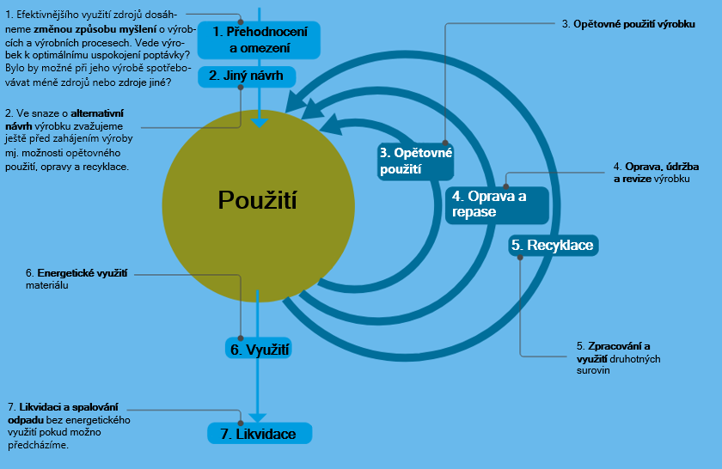
Víc než pouhá recyklace
Zdroj: Rood T a Hanemaaijer A, (2017). Opportunities for a circular economy. PBL Netherlands Environmental Assessment Agency, The Hague. www.pbl.nl

